Slide 1
Connecting to and Setting Up a Network
About the TCP/ IP protocols and standards Windows uses for networking
How to connect a computer to a network
How to configure and secure a multifunction router on a local network

Slide 2
UNDERSTANDING TCP/IP AND WINDOWS NETWORKING
When two computers communicate using a local network or the Internet, communication happens at three levels (hardware, operating system, and application).
The first step in communication is one computer must find the other computer.
The second step is both computers must agree on the methods and rules for communication (called protocols).

Slide 3
UNDERSTANDING TCP/IP AND WINDOWS NETWORKING…
Then one computer takes on the role of making requests from the other computer.
A computer making a request from another is called the client and the one answering the request is called the server. Most communication between computers on a network or the Internet uses this client/server model.

Slide 4
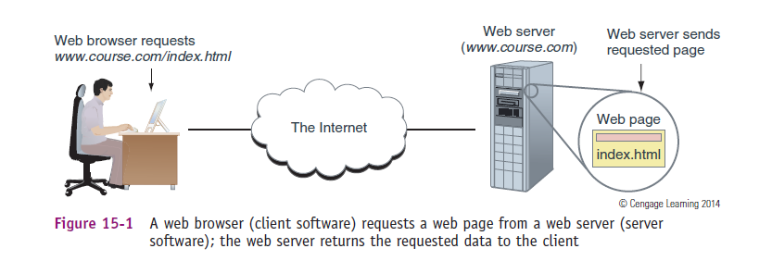
Client/Server model

Slide 5
LAYERS OF NETWORK COMMUNICATION
When your computer at home is connected to your Internet Service Provider (ISP) off somewhere in the distance, your computer and a computer on the Internet must be able to communicate.
When two devices communicate, they must use the same protocols so that the communication makes sense.
For almost all networks today, including the Internet, the group or suite of protocols used is called TCP/IP.

Slide 6
LAYERS OF NETWORK COMMUNICATION
Before data is transmitted on a network, it is first broken up into segments. Each data segment is put into a packet.
Part of the information included in a packet header is the address information needed to find the computer that is to receive the packet. The address information includes three levels: the address at the hardware level (called a MAC address), the address at the OS level (called an IP address), and the address at the application level (called a port address).

Slide 7
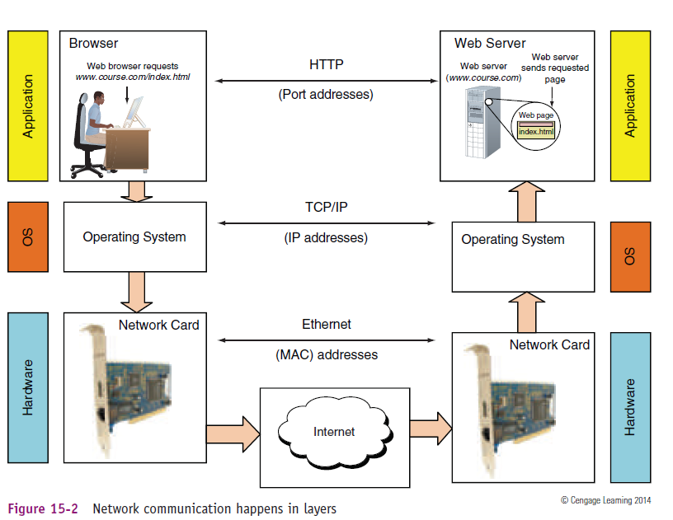
LAYERS OF NETWORK COMMUNICATION

Slide 8
Level 1: Hardware level.
This is the root level of communication. The hardware or physical connection might be wireless or might use network cables, phone lines (for DSL or dial-up), or TV cable lines (for a cable modem). For local wired or wireless networks, a network adapter inside your computer is part of this physical network

Slide 9
Level 1: Hardware level…
Every network adapter has a 48-bit (6-byte) number hard-coded on the card by its manufacturer that is unique for that device (see Figure 15-3). The number is written in hex, and is called the MAC (Media Access Control) address.

Slide 10
Level 2: Operating system level.
Operating systems use IP addresses to find other computers on a network.
An IP address is a 32-bit or 128-bit string that is assigned to a network connection when the connection is first made.
Whereas a MAC address is only used to find a computer on a local network, an IP address can be used to find a computer anywhere on the Internet

Slide 11
Level 3: Application level.
Most applications used on the Internet or a local network are client/server applications.
Client applications, such as Internet Explorer, Google Chrome, or Outlook, communicate with server applications such as a web server or email server.
Each client and server application installed on a computer listens at a predetermined address (port number, port, or port address) that uniquely identifies the application on the computer.

Slide 12
HOW IP ADDRESSES GET ASSIGNED
A MAC address is embedded on a network adapter at the factory, but IP addresses are assigned manually or by software.
IP address can be a dynamic IP address (IP address is assigned by a server each time it connects to the network) or a static IP address (IP address is permanently assigned to the computer or device).

Slide 13
HOW IP ADDRESSES GET ASSIGNED…
For dynamic IP addresses, a DHCP (dynamic host configuration protocol) server gives an IP address to a computer when it first attempts to initiate a connection to the network and requests an IP address.
An IP address has 32 bits or 128 bits.

Slide 14
HOW IP ADDRESSES GET ASSIGNED…
IPv6 addresses are written as eight groups of four hexadecimal digits, separated by colons (e.g., 2001:0db8:0000:0042:0000:8a2e:0370:7334).
Groups of consecutive zeros can be abbreviated with :: (e.g., 2001:db8::42:0:8a2e:370:7334).

Slide 15
HOW IPV4 IP ADDRESSES ARE USED
A 32-bit IP address is organized into four groups of eight bits each, which are presented as four decimal numbers separated by periods, such as 72.56.105.12.
The largest possible 8-bit number is 11111111, which is equal to 255 in decimal, so the largest possible IP address in decimal is 255.255.255.255, which in binary is 11111111.11111111.11111111.11111111.

Slide 16
HOW IPV4 IP ADDRESSES ARE USED…
Each of the four numbers separated by periods is called an octet (for 8 bits) and can be any number from 0 to 255, making a total of about 4.3 billion IP addresses (256 256 256 256).
Some IP addresses are reserved, so these numbers are approximations. E.g. Private IP Addresses (for internal networks), Loopback Addresses (Used by a host to send network traffic to itself), Link-Local Addresses (Used for communication between devices on the same physical link.)

Slide 17
HOW IPV4 IP ADDRESSES ARE USED…
The first part of an IP address identifies the network, and the last part identifies the host.
When data is routed over the Internet, the network portion of the IP address is used to locate the right network. After the data arrives at the local network, the host portion of the IP address is used to identify the one computer on the network that is to receive the data.
Finally, the IP address of the host must be used to identify its MAC address so the data can travel on the host’s LAN to that host.

Slide 18
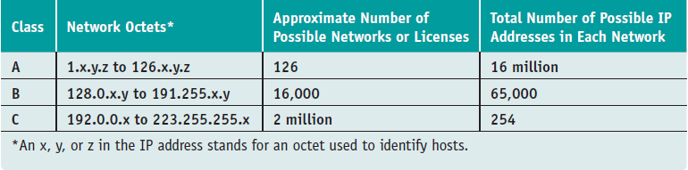
CLASSES OF IP ADDRESSES
IPv4 IP addresses are divided into three classes: Class A, Class B, and Class C. IP addresses belong in each class according to the scheme outlined in Table below:

Slide 19
CLASSES OF IP ADDRESSES…
Class A license is for a single octet, which is the network portion of the IP addresses in that license. The remaining octets can be used for host addresses or to identify subnetworks in the larger network.
For example, if a company is assigned 87 as its Class A license, then 87 is the network address and is used as the first octet for every host using this license (87.0.0.1, 87.0.0.2, 87.0.0.3, and so forth).

Slide 20
CLASSES OF IP ADDRESSES…
A Class B license leases the first two octets, and these first two octets are used for the network portion and the last two can be used for the host address or for subnetting the network.
An example of a Class B license is 150.35, and examples of IP addresses in this network are 150.35.0.1, 150.35.0.2, and 150.35.0.3.
The number of possible values for two octets is about 256 X 254, or about 65,000 host addresses in a single Class B license.

Slide 21
CLASSES OF IP ADDRESSES…
A Class C license assigns three octets as the network address. With only one octet used for the host addresses, there can be only 254 host addresses on a Class C network or its subnetworks.
For example, if a company is assigned a Class C license for its network with a network address of 200.80.15, some IP addresses on the network would be 200.80.15.1, 200.80.15.2, and 200.80.15.3.

Slide 22
CLASSES OF IP ADDRESSES…
Class D and Class E IP addresses are not available for general use. Class D addresses begin with octets 224 through 239 and are used for multicasting, in which one host sends messages to multiple hosts, such as when the host transmits a video conference over the Internet.
Class E addresses begin with 240 through 254 and are reserved for research.

Slide 23
SUBNETS USING IPV4
Managing a network with so many hosts is not practical unless you divide the network into subnets.
To divide a network into subnets, you designate part of the host portion of the IP address as a subnet.
For example, suppose you have a Class A license of 69. Without using subnets, you have one network: the first octet of all the IP addresses in this network is 69; the last three octets are used for host addresses; and the number of hosts in this one network is about 16 million.

Slide 24
SUBNETS USING IPV4…
Suppose you divide this one network into 256 subnets by using the second octet for the subnet address. (The subnets are 69.0.x.y through 69.255.x.y.) The last two octets are used for host addresses in each subnet with a potential of about 65,000 hosts in each subnet (256 x 254).
The subnet mask used with IPv4 identifies which part of an IP address is the network portion and which part is the host portion.

Slide 25
SUBNETS USING IPV4…
The subnet mask used with IPv4 identifies which part of an IP address is the network portion and which part is the host portion.
Using a subnet mask, a computer or other device can know if an IP address of another computer is on its network or another network.
If you don’t divide a network into subnets, the default subnet mask is used, which is called a classful subnet mask because the network portion of the IP address aligns with the class license.

